Slide 1

Final Presentation
Delilah Andrusko

Slide 2
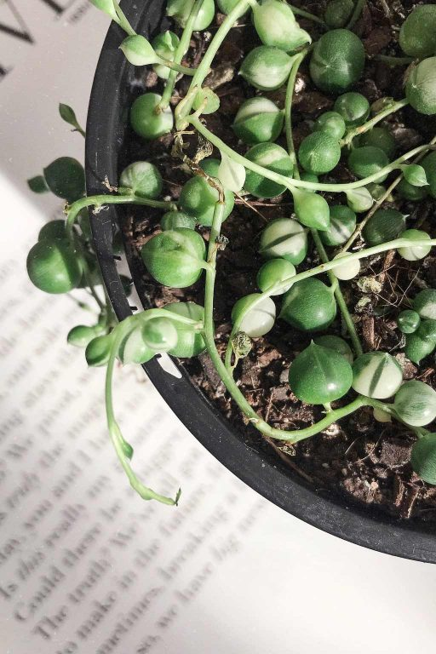
Overview
Focuses on a website for a small business that sells plants
Build it or Buy it route?
Time and Budget?
Integrations used
Future Improvements
Live Demo
.

Slide 3
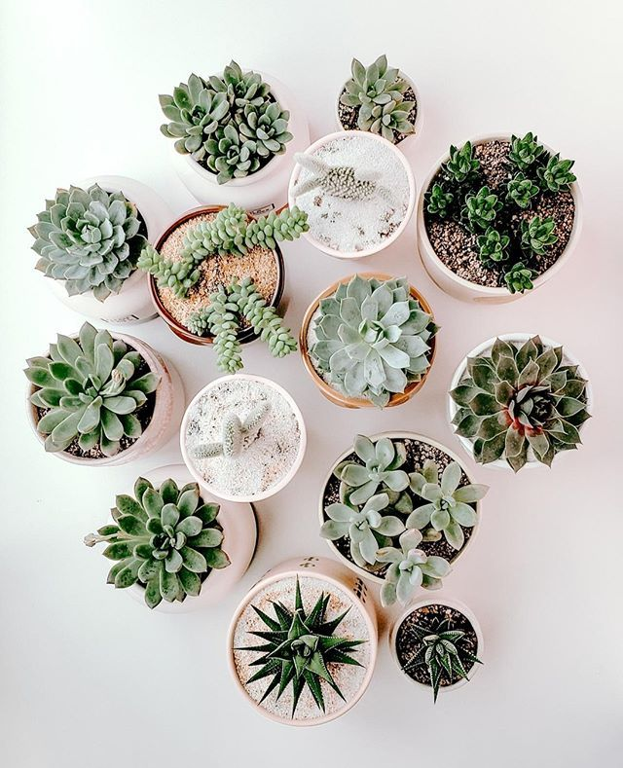
Tool & Budget
Theme - $30
Domain – $2
DreamHost with Security - $4.95
Software (Wordpress) for Implementation/Plugins – Free
Buy it route – efficiency
GitHub - documentation

Slide 4

Integrations
Theme
WooCommerce – Products/ Payments/Cart/Checkout
Themify – Filtering Options
Quiz
Notifications for error
Contact Form
Shipment
Billing

Slide 5

Backend of Integrations
Viewing Purchases made
Managing Product Stock
Low stock
Current Stock
Managing Products for sale

Slide 6

Future Improvements
Drop down menu when mouse hovers over drop down menu
More variety of plants
Accessories and tools for purchase
Accounts for memberships/plant subscription boxes
Add a plant of the month feature for homepage
Create a better designed Care guide where user can search for their specific plant and learn how to care for it.

Slide 7

Live Demo
URL : https://lilahsplant.xyz/
Features to go through
Quiz
Shop
Cart
Checkout
Care Guide
Cart

